Slide 1
Self-accelerating Processing Workflows
Progress Presentation
Supervisors:
Dr Adeesha Wijayasiri, CSE, UOM
Mr Janaka Perera, LSEG.
Group members
160007J - Balarajah Abinayan
160256U - Jeyakeethan Jeyaganeshan
160442L - Thiyakarasa Nirojan

Slide 2
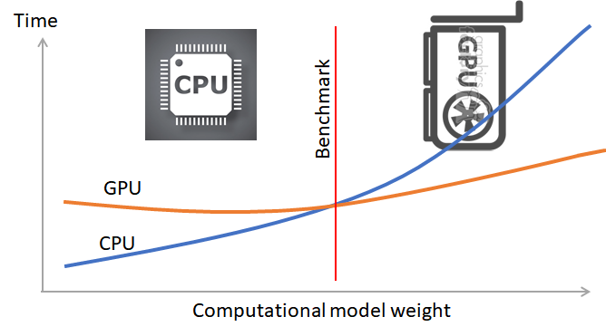
Introduction
A particular task can be executed in both CPU or GPU but the execution time may vary depending on many factors.

Slide 3
Introduction
Profit from different processing units for the tasks are varying and depending on various factors such as properties of the accelerators, deployment environment, time of the day, complexity of the tasks and system’s current state influence significantly, e.g. contention [14][19].
Hence, the tasks cannot be pre-classified whether they are efficient to run on GPU or CPU during the programming period.

Slide 4
Introduction
Inappropriate scheduling of computations into wrong processors are inefficient and time consuming [17].
Many applications utilize GPUs to seek gain but leave CPUs sitting idle [18].
At this moment Programmer has to switch the application manually.

Slide 5
Problem Statement
Develop a framework that predicts the optimal processor at runtime which has less latency and high throughput for computations at different instances in a heterogeneous environment.

Slide 6
Research Motivation
Appropriate selection of optimal processor reduces the overall execution times of the computations.
low latency and high throughput can be achieved.
It can also prevent starvation of data stream in some instances.
The overall performance of the system can be improved like by the branch predictor in CPU hardware.

Slide 7
Objectives and Expected Outcomes
A hardware independent framework that predicts optimal processing units using a selection strategy by evaluating some properties given by the programmer related to the task and through obtaining some performance matrices during runtime.
It should be able to integrate new computational models defined by the programmer.
The solution should adapt to the nature of input computations and avoid them assigned to wrong units.
The evaluation process should be asynchronous to avoid latency in the system by its processing.
Notes:
A hardware independent library that evaluates computational models whether the models should better be executed in GPU or CPU.

Slide 8
Literature Review - Selection mechanism
Document | Methods | Key Points
Seamlessly Portable Applications [14] | DLS will look the performance database to analyse the history runs of that particular implementation and compare the time taken to execute with the other implementation for that particular problem size. | Once the platform is selected, it wont switch to other platform during runtime. Only history based runs are selected
Adaptive runtime selection for GPU [17] | Whichever the version that finishes the tasks first will kill the other run | Using resource for redundant calculation.
Toward an Analytical Performance Model [16] | Machine-Learning-based algorithms may achieve high degrees of accuracy, but may also suffer from some drawbacks that limit their applications. | Applicability of such solutions is often limited in production systems. The need for runtime-available parameters in ML solutions leads to overhead for inference at runtime.

Slide 9
Literature Review - Selection mechanism
Document | Methods | Key Points
STARPU A Unified Platform for Task Scheduling on Heterogeneous Multicore Architectures [18] | Providing user selectable scheduling mechanism | Once selected, same mechanism is used throughout the run.
Workload Partitioning for Accelerating Applications on Heterogeneous Platforms [19] | Workload partitioning using online and offline profiling | Function nature is not considered. Only data transfer and hardware computational capacity is considered.
Automatic task mapping and heterogeneity-aware fault tolerance [15] | Using performance database to select the accelerator based on previous run. | Won't be effective if there are no previous run.

Slide 10
Literature Review - Experimental Mechanism
Document | Methods | Key Points
Runtime Coordinated Heterogeneous Tasks in Charm++ [22] | Use Accel framework to select the strategy | Limited to the selection strategies presented in the framework.
Cost-Aware Function Migration in Heterogeneous Systems | The idea is based on online learning of the implementations which assist in guided execution of the best implementation. | This technique is similar to the history based selection.

Slide 11
Methodology
We conducted the experiment in following categories.
Raw GPU Experiment
Task Based Experiment
Deployment System Experiment
Raw Execution Time Based Analysis
Nature of input data based analysis
Notes:
Since the research depends on different groups of aspects, dealing with them all, without classifying them based on their nature will not result in efficient results The research is subdivided in order to perform the experiments in an efficient way. Though this system can be used for any tasks, for experimental purposes we choose matrix addition as an example.
We have got into the scope by doing step by step experiments.
Since the research depends on different groups of aspects, dealing with them all without classifying them based on their nature will not result in efficient results .The research is subdivided in order to perform the experiments in an efficient way. Though this system can be used for any tasks, for experimental purposes we choose matrix addition as an example.

Slide 12
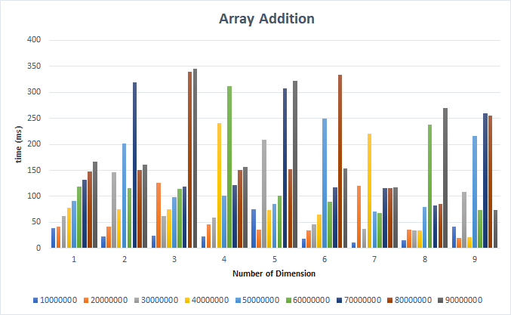
Methodology - Raw GPU Experiment
Notes:
We first did experiment only in GPU by changing factors influencing execution time to understand how an GPU behaves with the factors.
GPU is good at parallel computing
Research papers stated

Slide 13
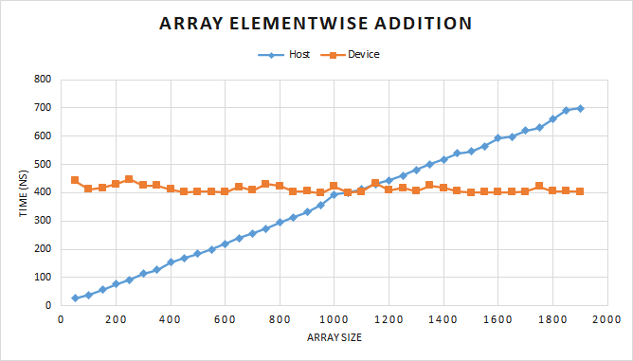
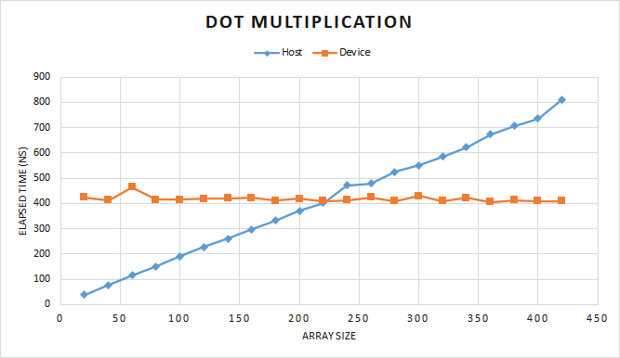
Methodology - Task Based Experiment
We experimented and calculated execution time for array addition and dot multiplication with varying array size on CPU and GPU.
Notes:
Got crossing point
Research papers stated about cutting point

Slide 14
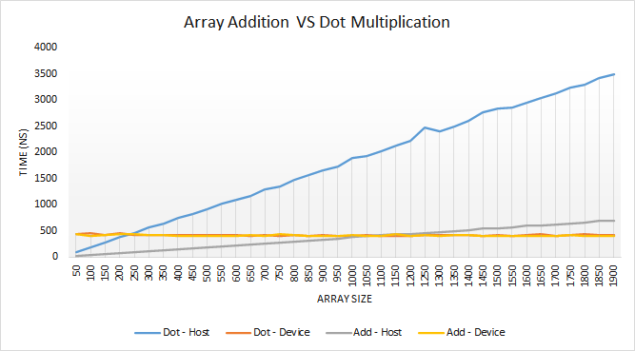
Methodology - Task Based Experiment
CPU to cross the boundary happens soon when the computation become more computationally intensive
Notes:
The GPU time roughly not vary with the size. The CPU time increasing with the array size, but cross over the GPU time at a point, which meant to be the boundary point here.

Slide 15
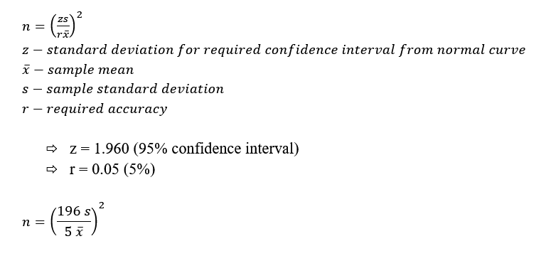
Methodology - Task Based Experiment
Notes:
Got crossing point
Research papers stated about cutting point

Slide 16
Methodology - Deployment System Experiment
Experimented in multiple machines
Array Size | Host Time | Device Time
100 | 0.00212042 | 0.00039633
200 | 0.00444981 | 0.00023719
-- | -- | --
800 | 0.01605261 | 0.000225
900 | 0.0176719 | 0.00022228
1000 | 0.01917692 | 0.0002281
1100 | 0.02090968 | 0.00022673
1200 | 0.02668534 | 0.00022467
1300 | 0.02593127 | 0.00026113
Array Size | Host Time | Device Time
100 | 0.00032395 | 0.00247511
200 | 0.00047535 | 0.00152941
-- | -- | --
800 | 0.00105543 | 0.00149808
900 | 0.00123664 | 0.00152057
1000 | 0.00199642 | 0.00166710
1100 | 0.00270865 | 0.00209979
1200 | 0.00233752 | 0.00320343
1300 | 0.00300046 | 0.00151011
Notes:
After experimented in multiple machines we come to an idea that, we can’t define static benchmark for mapping a
task to processing units.
We went through several hardware related research papers and we drop the idea of doing hardware based experiments since it is irrelevant to our problem and proposed solution.

Slide 17
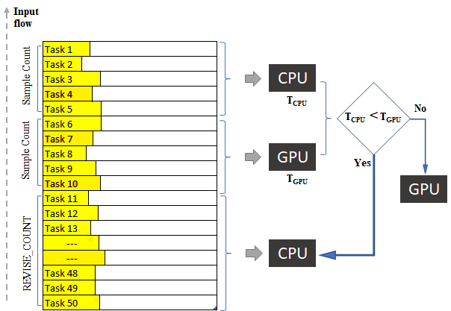
Methodology - Raw Execution Time Based Analysis
We experimented based on raw execution time after we had implemented a framework.
We have followed various approaches.
Last N Average Time Comparison
Sample Execution Time Algorithm
Sample Algorithm with Varying Revise Count
Notes:
we can’t define static benchmark for each task since the boundary points depend on several factors as we have seen before.
We will evaluate some tasks coming first and set the optimal processor for upcoming tasks for a certain count.
task to processing units.

Slide 18
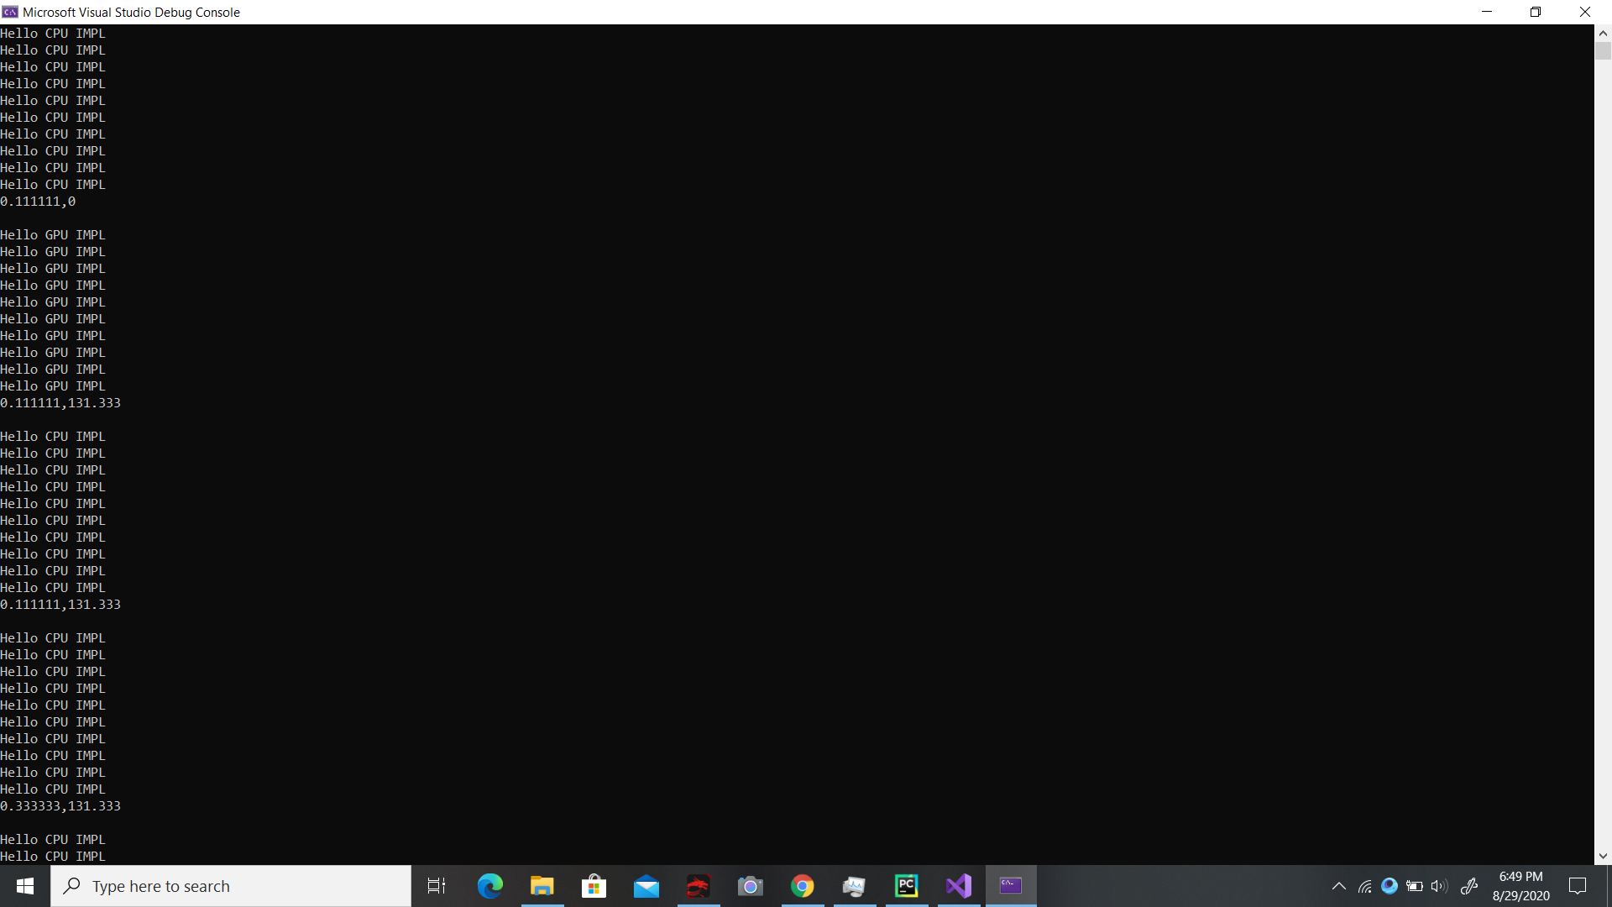
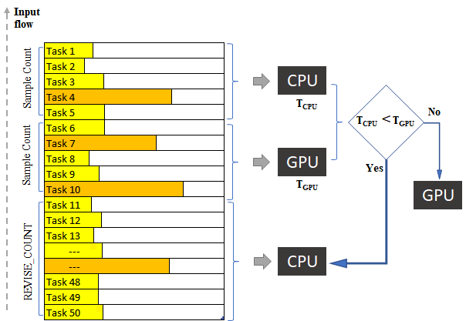
Methodology - Last N Average Time Comparison

Slide 19
Methodology - Last N Average Time Comparison
Problem :- There may be instances one processor sitting idle if execution time has raised to high value due to some unexpected issues.
Therefore, the other accelerator continues the execution forever which makes this approach inefficient.
Notes:
We had to use mutex lock to avoid race condition when updating share values in the model classes. There was a huge overhead and then asynchronous evaluation method has been dropped .

Slide 20

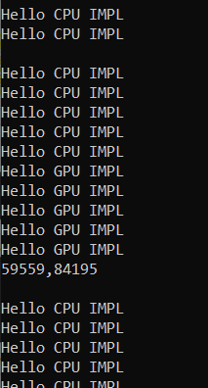
Methodology - Sample Execution Time Algorithm

Slide 21
Methodology - Sample Execution Time Algorithm
Lacks in this approach:
It is hard to select the most appropriate REVISE_COUNT value.
It is waste to evaluate samples unwantedly if one accelerator specific problems are arriving continuously.
Evaluating the samples every fixed count adding overhead to the processing and it recoup the gain over the latency from the algorithm.

Slide 22

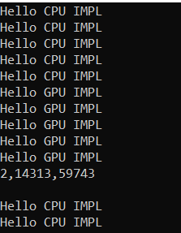
Methodology - Sample Algo with Varying Revise Count
Notes:
We are striving to optimize this algorithm further if there is break in the flow it will reset the revise count to minimum value

Slide 23
Methodology - Sample Algo with Varying Revise Count
Problems in this version of selection algorithm is it cannot tackle with all kind of the nature of the input data.
We need to consider the results from the Task Based Experiment with current version of algorithm to determine solution for this issue.
Notes:
This is our current position in improving algorithm track and it can be optimized further
The present algorithm cannot detect such anomaly cases since it does not consider the weights of the computation any way.
It cannot handle pure odd input stream, means the noisy input stream.
It will cause a severe loss if a very big computation comes when the CPU is in operation.

Slide 24
Methodology - Nature of Input Data
Even Input
Odd Input
Notes:
input stream means input cases coming one after another, we call it input stream
We classify the input streams mainly into two
In even input stream, similar input data comes in cluster which is beneficial to our algorithm.
In contrast in odd input stream, the input data arrives completely in random sizes

Slide 25
Methodology - Nature of Input Data
In this analysis, we experimented with 5 nature of input data
CPU Specific Input Stream
GPU Specific Input Stream
Square Aligned Wave Input Stream
Binary Aligned Input Stream
Odd Input Stream
Notes:
in this analysis, we experimented with 5 kinds of input streams
With the sample algorithm with varying revise count approach
The input streams are generated randomly but characteristics of the streams have been logged and graphs drawn.
Also, the the execution times for CPU only, GPU only and Self flow have been logged.
We have achieved gains in 4 out 5 of the input stream types.
We will go through them one by one
This algorithm is finalized as the strategy, the way the proposed solution will be implemented.

Slide 26
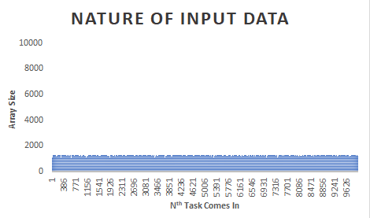
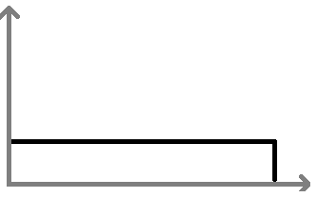
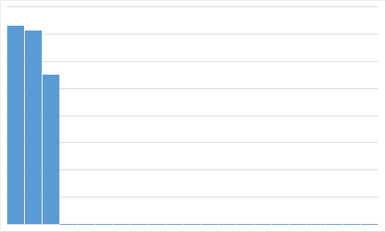
Methodology
CPU Specific Input Stream
Array Size
Self Flow Time: 1925 ms
CPU Only Time: 263 ms
GPU Only Time: 34406 ms
Notes:
Element wise addition of two equal size arrays
Graphs illustrating the nature of the input stream.
vertical axis shows array size
Horizontal axis shows input stream flow order
The first graph on right shows square wave of the same graph
And the second graph shows overall distribution of the array sizes given for the experiment. Just for the counting.
We have evaluated in three cases.
First one is only on CPU, then only on GPU and finally with our framework
and the times are logged and displayed here.
Near to the optimal processor, in this case,the CPU

Slide 27
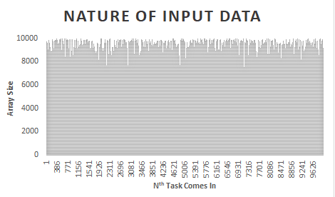
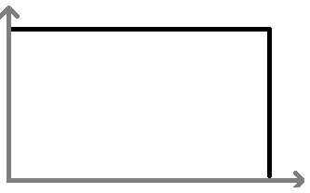
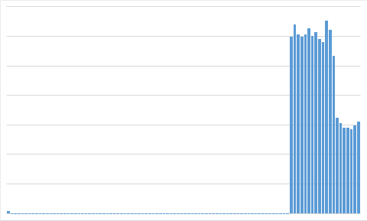
GPU Specific Input Stream
Array Size
Self Flow Time: 34084 ms
CPU Only Time: 34101 ms
GPU Only Time: 30389 ms
Notes:
Selflow time has exceeded the GPU only time, which was not a gain at this time.
because that some samples are executed in CPU for evaluations and got delayed
It can be optimized by preventing the Highly GPU specific tasks executed in the CPU at all.
We will consider the characteristics of the tasks in the next improved algorithm to solve this issue.

Slide 28
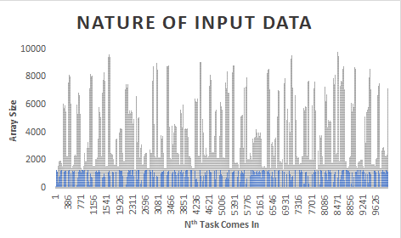
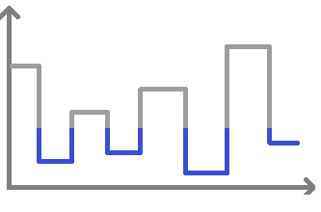
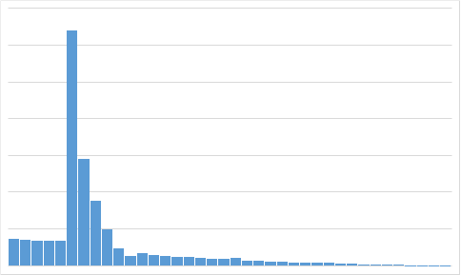
Square Aligned Wave Input Stream
Self Flow Time: 2062 ms
CPU Only Time: 785 ms
GPU Only Time: 35921 ms
Notes:
The blue lines in the graphs indicate input clusters favourable for the CPU.
And the ash lines indicate input clusters favourable for the GPU.
Inputs are comes in cluster, alternatingly favourable for CPU and GPU.
But the widths of the cluster are random values.
Most of the time in our experiments the self flow times are closer to the smaller value
but some time less than both which can be considered as high successes of this research.

Slide 29
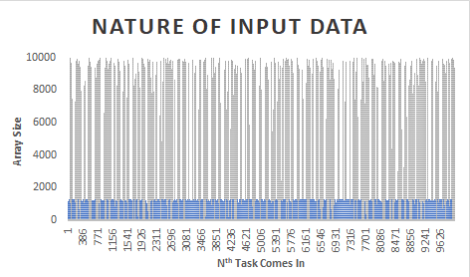
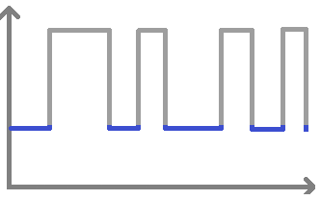
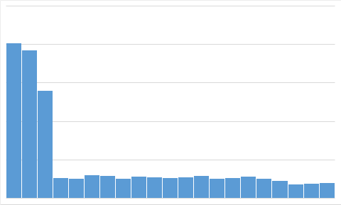
Binary Aligned Input Stream
Self Flow Time: 2436 ms
CPU Only Time: 2936 ms
GPU Only Time: 41697 ms
Notes:
In this case, the clusters alternating between two maximum values waves as you can see in the square wave on the right.
Here we have got the Self Flow Time less than the CPU and the GPU. highly success point
The algorithm almost sensitive to the binary edges and executing them in the appropriate processing units.

Slide 30
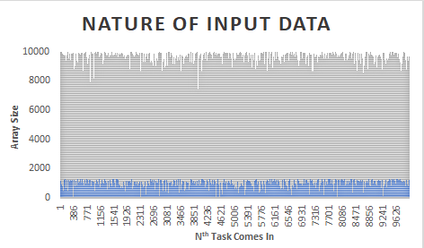
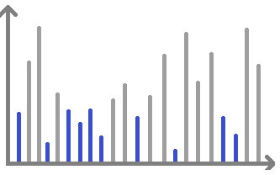
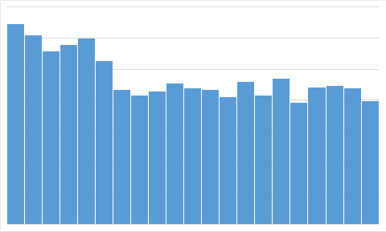
Odd Input Stream
Self Flow Time: 10545 ms
CPU Only Time: 16579 ms
GPU Only Time: 55062 ms
Notes:
There will be no cluster in this input stream. The sizes are alternating zig zags between two fixed values set.
In this case also the self flow time achieved a great gain, less than the cpu and gpu
Which is an unexpected scenario.
It might be because of the throughput from executing the input stream on both processing units in random path taken by the algo.
The REVISE COUNT value should have not been incremented in this case
It should have been stays at the minimum always.

Slide 31
...proposed Solution
A hardware independent framework implemented in C++ contains computational models.
Programmers will create an object of any of the models with some system specific parameters such as number of cores in CPU, etc.
Each time a programmer wants to use the model, he will set the data and call execute() method on the object.
The execute() method will invoke the best from two functions implemented for CPU and GPU implicitly.
Notes:
Array size

Slide 32
Selection mechanism
Notes:
Initially, two consequent disjoint sample sets are executed and evaluated in the processing units and the optimal one set for the rest up to a number, called REVISE_COUNT.
After the REVISE_COUNT exceeded, again samples from each evaluated and switch the processing unit if needed.

Slide 33
...proposed solution
Initially, two adjacent disjoint sample sets are executed and evaluated in the processing units and the optimal one set for the rest up to a number, called REVISE_COUNT.
After the REVISE_COUNT exceeded, again samples from each evaluated and switch the processing unit if needed.
He can manually set to a fixed processing unit for a problem by giving the unit id to the execute method. E.g. execute(1); for CPU.
Manual mode will not be evaluated and is there for the policy of implementation reusability.

Slide 34
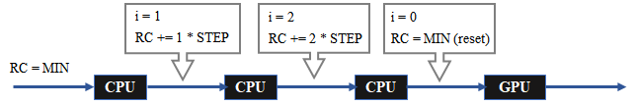
...proposed solution
REVISE_COUNT is incremented if the same unit is selected for the next period but reset to a minimum value if the unit has been switched.
A new computational model can be added to the framework with custom implementations.
Programmer has to extend a class, “ComputationalModel” and must override two abstract methods, CPUImplementation and GPUImplementation.
Notes:
Array size

Slide 35
Timeline and Future Tasks
Month | Task breakdown | Status
April | Extracting features Prioritizing features Set the features into classe | Completed In progress In progress
May | Group the features for functions Implement related algorithm | Completed
June | Measuring the impacts of the features Create models and design of the Library | In progress
July | Implement and code the Library | In progress
August | Prepare for mid evaluation | Completed
Notes:
As we have planned out milestones are accomplished on time and remainings are in progress.

Slide 36
Timeline and Future Tasks
Optimize the algorithm with varying REVISE_COUNT adapt to the problem stream nature.
Combine the results from the Task Based Experiment with selection algorithm to determine optimal processor.
Make the process asynchronous to reduce the overhead due to the framework calculations.
Complete implementation and evaluate the library.
If time permits, explore more functions, analyze their suitability and REVISE_COUNT relations.
Notes:
These are our future tasks need to be done
Optimize the algorithm with varying REVISE_COUNT adapt to the problem stream nature.
Consider some tasks based properties when evaluating the processing units.
Make the process asynchronous to reduce the overhead due to the framework calculations.
Complete implementation and evaluate the library.
If time permits, explore more functions, analyze their suitability and REVISE_COUNT relations.

Slide 37
Summary
Evaluate processing problems in relation to their execution time determining factors.
A library of functions predicts which processor would offer less execution time.
The framework switch processor evaluating few samples runtime periodically.
This solution can be scaled up to other complex computations.
This research will push the heterogeneous computings into another dimension.

Slide 38
References
[1] Z. Memon, F. Samad, Z. Awan, A. Aziz and S. Siddiqi, "CPU-GPU Processing", IJCSNS International Journal of Computer Science and Network Security, Vol.17, No.9, September 2017. [Accessed on: 30- Dec- 2019] [Online].
http://paper.ijcsns.org/07_book/201709/20170924.pdf
[2] A. Syberfeldt and T. Ekblom, “A comparative evaluation of the GPU vs. The CPU for parallelization of evolutionary algorithms through multiple independent runs”, International Journal of Computer Science & Information Technology (IJCSIT) Vol 9, No 3, June 2017. [Accessed: 31- Dec- 2019] [Online].
http://aircconline.com/ijcsit/V9N3/9317ijcsit01.pdf
[3] S. Brinkmann (2020). “ResearchGate” [Accessed:21 Jan. 2020] [Online].
https://www.researchgate.net/post/Anyone_have_experience_in_programming_CPU_GPU_What_is_the_real_benefit_in_moving_everything_possible_from_CPU_to_GPU_programming
[4] Vella, F., Neri, I., Gervasi, O. and Tasso, S. (2012). A Simulation Framework for Scheduling Performance Evaluation on CPU-GPU Heterogeneous System. Computational Science and Its Applications – ICCSA 2012, pp.457-469. [Accessed:21 Jan. 2020] [Online].
https://link.springer.com/chapter/10.1007/978-3-642-31128-4_34

Slide 39
[5] NVIDIA Corporation, 2020. NVIDIA’s Next Generation CUDA Compute Architecture - White Paper. [Accessed 27 March 2020] [online].
https://www.nvidia.com/content/PDF/fermi_white_papers/NVIDIA_Fermi_Compute_Architecture_Whitepaper.pdf
[6] Cullinan, C., Wyant, C. and Frattesi, T., 2020. Computing Performance Benchmarks among CPU, GPU, and FPGA. [Accessed 27 March 2020] [online].
http://Computing Performance Benchmarks among CPU, GPU, and FPGA
[7] S. Goyat, A. Sahoo, “Scheduling Algorithm for CPU-GPU Based Heterogeneous Clustered Environment Using Map-Reduce Data Processing”, ARPN Journal of Engineering and Applied Sciences, Vol. 14, No. 1, January 2019. [Accessed on: 31- Dec- 2019] [Online].
http://www.arpnjournals.org/jeas/research_papers/rp_2019/jeas_0119_7546.pdf
[8] NVIDIA Organization, 2018. Docs.nvidia.com. [Accessed 27 March 2020] [online].
https://docs.nvidia.com/cuda/archive/9.1/pdf/CUDA_C_Programming_Guide.pdf

Slide 40
[9] Lee, V., Kim, C., Chhugani, J., Deisher, M., Kim, D., Nguyen, A., Satish, N., Smelyanskiy, M., Chennupaty, S., Hammarlund, P., Singhal, R. and Dubey P., “Debunking the 100X GPU vs. CPU myth: an evaluation of throughput computing on CPU and GPU”. [online] [Accessed 29 March 2020]
https://dl.acm.org/doi/pdf/10.1145/1815961.1816021?casa_token=WGkb9giVyI8AAAAA:n3DRHmgyO46x6w3e-F12nW-pGJ9P9Pjzvntbs6DdXp4Eg2fYzQxo43Akqde585XkHFjEaDDi0oOd
[10] Chikin, A., Amaral, J., Ali, K., Tiotto, E., “Toward an Analytical Performance Model to Select between GPU and CPU Execution”. [online] [Accessed 8 August 2020]
https://ieeexplore.ieee.org/document/8778216/
[11] Bakkum, P. and Skadron, K., 2010. Accelerating SQL Database Operations on a GPU with CUDA. [Accessed 27 March 2020] [online].
https://www.cs.virginia.edu/~skadron/Papers/bakkum_sqlite_gpgpu10.pdf
[12] P. C. Pratt-Szeliga, J. W. Fawcett and R. D. Welch, "Rootbeer: Seamlessly. Using GPUs from Java," 2012 IEEE 14th International Conference on High-Performance Computing and Communication & 2012 IEEE 9th International Conference on Embedded Software and Systems, Liverpool, 2012, pp. 375-380.
https://ieeexplore.ieee.org/document/6332196

Slide 41
[13] C. Cullinan, C. Wyant, and T. Frattesi, “Computing Performance Benchmarks among CPU, GPU, and FPGA”, 2020 p.15. [online] [Accessed 29 March 2020]
https://web.wpi.edu/Pubs/E-project/Available/E-project-030212-123508/unrestricted/Benchmarking_Final.pdf
[14] M. Kicherer, F. Nowak, R. Buchty and W. Karl, "Seamlessly portable applications: ACM Transactions on Architecture and Code Optimization”, vol. 8, no. 4, pp. 1-20, 2012. Available: 10.1145/2086696.2086721 [Accessed 27 August 2020].
https://dl.acm.org/doi/pdf/10.1145/2086696.2086721
[15] M. Kicherer and W. Karl, “Automatic task mapping and heterogeneity-aware fault tolerance: The benefits for runtime optimization and application development”, Journal of Systems Architecture - Embedded Systems Design, 2015. [online] [Accessed 29 March 2020].
https://dl.acm.org/doi/10.1016/j.sysarc.2015.10.001
[16] A. Chikin, J. Amaral, K. Ali and E. Tiotto, Toward an Analytical Performance Model to Select between GPU and CPU Execution, 2019. Available: https://ieeexplore.ieee.org/document/8778216. [Accessed 30 August 2020].
https://doi.org/10.1016/j.sysarc.2015.10.001

Slide 42
[17] J. Dollinger and V. Loechner, "Adaptive Runtime Selection for GPU," 2013 42nd International Conference on Parallel Processing, Lyon, 2013, pp. 70-79, doi: 10.1109/ICPP.2013.16. [online] [Accessed 29 March 2020].
https://ieeexplore.ieee.org/document/6687340
[18] C. Augonnet, S. Thibault, R. Namyst, PA., Wacrenier, “StarPU: A Unified Platform for Task Scheduling on Heterogeneous Multicore Architectures”, 2009. Lecture Notes in Computer Science, vol 5704. Springer, Berlin, Heidelberg. [online] [Accessed 29 March 2020].
https://doi.org/10.1007/978-3-642-03869-3_80
[19] J. Shen, A. L. Varbanescu, Y. Lu, P. Zou and H. Sips, "Workload Partitioning for Accelerating Applications on Heterogeneous Platforms," in IEEE Transactions on Parallel and Distributed Systems, vol. 27, no. 9, pp. 2766-2780, 1 Sept. 2016, doi: 10.1109/TPDS.2015.2509972. [online] [Accessed 29 March 2020].
https://ieeexplore.ieee.org/document/7360199
[21] M. P. Robson, R. Buch and L. V. Kale, "Runtime Coordinated Heterogeneous Tasks in Charm++," 2016 Second International Workshop on Extreme Scale Programming Models and Middlewar (ESPM2), Salt Lake City, UT, 2016, pp. 40-43, doi: 10.1109/ESPM2.2016.011. [online] [Accessed 29 March 2020].
https://ieeexplore.ieee.org/document/7831559

